Slide 1
Data
Visual
PROJECT NAME
Here is where your presentation begins
MONTH / 20XX

Slide 2

Contents of
this template
Fonts
Colors
Thanks slide
Icons and infographics
To view this template correctly in PowerPoint, download and install the fonts we used
You can see on the link all the colors used in this presentation
You must keep it so that proper credits for our design are given
These can be used in the template, and their size and color can be edited
For more info: SLIDESGO | SLIDESGO AI TOOLS | BLOG | FAQs
You can edit the master slides easily. For more info, click here
You can visit our sister projects: FREEPIK AI TOOLS | FREEPIK LIBRARY RESOURCES
You can delete this slide when you’re done editing the presentation

Slide 3
Table
of contents
01
05
02
06
03
07
04
08
Name of the section
Name of the section
Name of the section
Name of the section
Name of the section
Name of the section
Name of the section
Name of the section

Slide 4
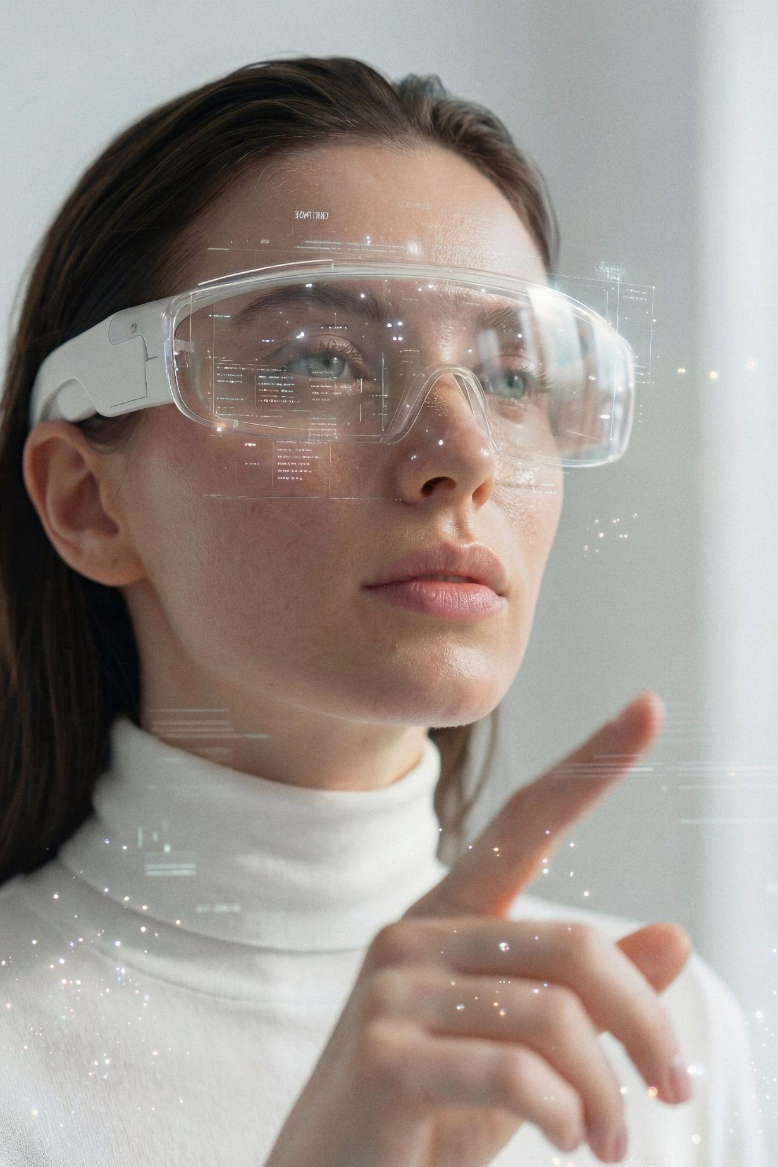
You can write here a
long title to captivate the audience attention
PROJECT NAME
Do you know what helps you make your point clear? Lists like this one:
They’re simple
You can organize your ideas clearly
You’ll never forget to buy milk!
You can replace the image. Just right-click on it and select “Replace image”
MONTH / 20XX

Slide 5
Name of the
section
01
PROJECT NAME
MONTH / 20XX

Slide 6
Let’s
have
a look
PROJECT NAME
Mercury is the closest planet to the Sun and the smallest one in the entire Solar System. This planet’s name has nothing to do with the liquid metal, since Mercury was named after the Roman messenger god. Despite being closer to the Sun than Venus, its temperatures aren't as terribly hot as that planet’s. Its surface is quite similar to that of Earth’s Moon, which means there are a lot of craters and plains. Speaking of craters, many of them were named after artists or authors who made significant contributions to their respective fields. Mercury takes a little more than 58 days to complete its rotation, so try to imagine how long days must be there!
MONTH / 20XX

Slide 7
Our
history
01
02
03
04
This is Venus
This is Saturn
This is Mars
This is Neptune
Venus is the second planet from the Sun
Saturn is composed of hydrogen and helium
Despite being red, Mars is actually a
cold place
Neptune is the farthest planet from the Sun

Slide 8
Key metrics
333,000
12,742 km
386,000 km
24 hours
How many times the Sun’s mass is compared to Earth’s
The average diameter of Earth at the equator
Distance between Earth and the Moon
The duration of a full rotation of Earth (1 day)

Slide 9
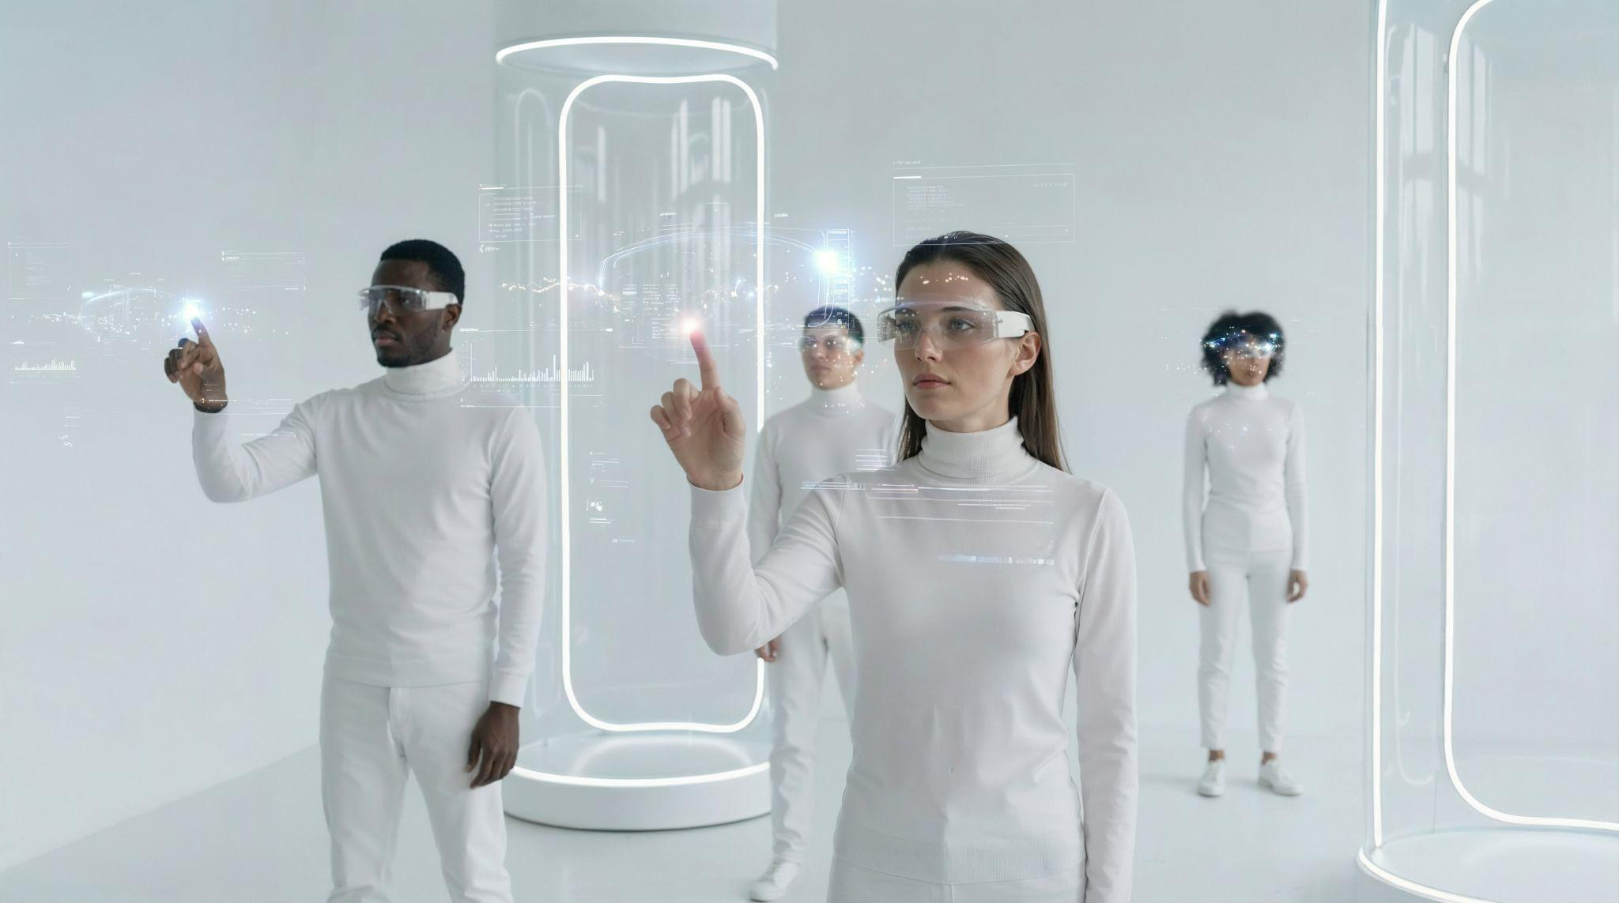
You can give a brief description of the topic you want to talk about here. For example, you can say that Mercury is the smallest planet in the entire Solar System

Slide 10
Thank
you
Do you have any questions?
youremail@freepik.com
+00 000 000 000
yourwebsite.com

Slide 11
Fonts
Colors
This presentation has been made using the following fonts:
All the colors used in this presentation
Click on the button of the link to the fonts
#262626
#e1eaff
#676ffe
Stack Sans Notch
#1dd38b
#929cf4
#ffffffff
Kedebideri
To view this template correctly in PowerPoint, download and install the fonts we used

Slide 12
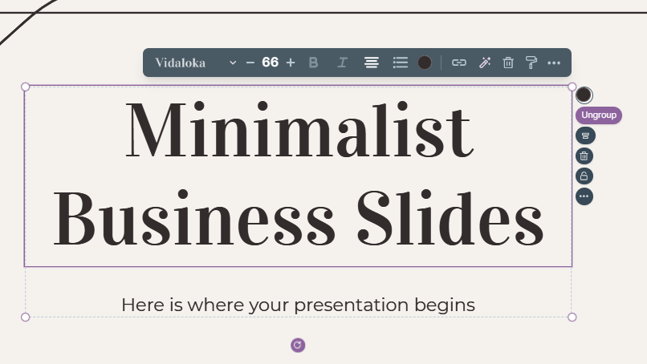
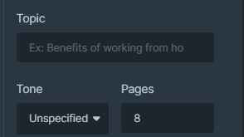
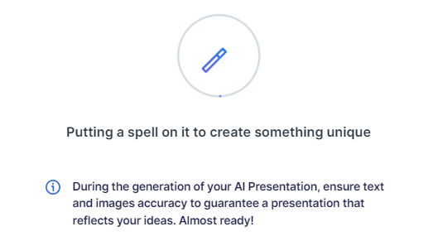
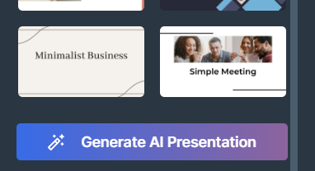
Presentation Maker
Slidesgo introduces its latest feature: the Presentation Maker. Enjoy two main functionalities - firstly, with a few clicks, create marvelous presentations with Artificial Intelligence that adapt to your needs. And it's completely free
Generate AI Presentation

Slide 13
Use our editable graphic resources...
You can easily resize these resources without losing quality. To change the color, just ungroup the resource and click on the object you want to change. You can also look for more infographics on Slidesgo

Slide 16
 | Jan | Feb | Mar | Apr | Jun
Task 1
Task 2
Task 3
 | No | Yes | Yes | No | Yes
 | Yes | No | Yes | No | Yes
 | Yes | Yes | No | Yes | No
 | Jan | Feb | Mar | Apr | Jun
Task 1
Task 2
Task 3

Slide 18
6/10 | 8/10 | 7/10 | 4/10

Slide 19
...and our sets of editable icons
You can resize these icons without losing quality
You can change the stroke and fill color; just select the icon and click on the paint bucket/pen
In Google Slides, you can also use Flaticon’s extension, allowing you to customize and add even more icons

Slide 20
Educational icons
Medical icons

Slide 21
Business icons
Teamwork icons

Slide 22
Help & support icons
Avatar icons

Slide 23
Creative process icons
Performing arts icons

Slide 24
Nature icons

Slide 25
SEO & marketing icons

Slide 26
Premium infographics
Mercury
Mars
Venus
Mercury is the closest planet to the Sun and smallest one
Despite being red, Mars is actually a very cold place
The Solar System
2xxx
2xxx
2xxx
2xxx
2xxx
Venus is the second planet from the Sun and is terribly hot
Jupiter is a gas giant and the biggest planet in the Solar System
Saturn is a gas giant and has several and beautiful rings
Earth
Jupiter
Saturn

Slide 27
Premium infographics
75%
15%
Mars is very cold
30%
Jupiter is a gas giant
Mercury
Mercury is the closest planet to the Sun and the smallest of them all
75%
30%
Saturn has rings

Slide 28
Premium icons
Digital marketing

Slide 29
Premium icons
Online learning

Slide 30
Premium icons
Laboratory

Slide 31
Premium icons
Goals & results

Slide 32
Premium icons
Infographic elements

Slide 33


